Slide 1

JAVA FOUNDATIONS & OBJECT-ORIENTED PROJECT PRESENTATION
University Library Management System
Automating Circulation, Inventory, and Academic Book Discovery in Java
TEAM NO
STUDENT MEMBERS
Team 01
R. Deethya • 2620030064
T. Abhigna • 2620030455
K. Keerthi Priya • 2620030495

Slide 2
SLIDE 01 • EXECUTIVE SUMMARY
Abstract
System Overview
University Library Management System is a computerized application designed to simplify and automate the daily operations of a university library. Traditional library management involves maintaining book records, student information, issue and return details, and fine calculations manually, which can be time-consuming and prone to errors. The proposed system provides a centralized platform for efficiently managing these activities.
Core Objectives & Scope
The system maintains details of books, students, librarians, availability, and transactions. Librarians manage records while students check availability. Future enhancements include barcode/QR scanning, online reservations, email notifications, mobile support, and digital library integration.
University Library Management System
Project Presentation

Slide 3



SLIDE 02 • CHALLENGES
Understanding Problem Statement
Manual Inefficiencies
Tracking Challenges
Fine Calculation Gaps
Paper records for book issues, returns, and memberships are time-consuming and error-prone.
Difficult to verify real-time book availability and student borrowing limits manually.
Inconsistent calculation of overdue penalties leading to administrative disputes.
University Library Management System
Project Presentation

Slide 4


SLIDE 03 • CO 1 TOPICS
Module 1 - From Problem to Program: Computational Thinking & Java Foundations
Problem Solving & Flow
Java Model & Primitives
Operators & I/O
Introduction to problem solving, algorithm design, and flowcharts applied to library circulation workflows.
Java environment, structure, primitive data types, variables, constants, identifiers, and literals.
Arithmetic, relational, logical, assignment, ternary, bitwise operators, typecasting, expressions, and Scanner I/O.
University Library Management System
Project Presentation

Slide 5



SLIDE 04 • CO 2 TOPICS
Module 2 - Control Flow: Selection & Iteration Control
Conditional Branching
Switch Menus
Iteration & Loops
Implemented if, if-else, nested-if, and if-else-if ladders to check book availability and member borrowing eligibility.
Switch statements with default, break, and compound statements for librarian and student dashboard navigation.
Utilized while, do-while, for loops, continue statements, infinite loops, and nested loops for batch transaction processing.
University Library Management System
Project Presentation

Slide 6
SLIDE 05 • CO 3 TOPICS
Module 3 - Decomposition with Methods, Recursion & Arrays
Modular Programming
Recursion & 1D Arrays
2D-Array Matrices
Methods definition, invocation, parameters, return values, overloading, and enhanced for-each loops.
Recursive base/recursive cases, 1D-array traversal, searching, summation, average, and counting book logs.
Utilized 2D-array matrices for multi-departmental library inventory and rack allocation arithmetic.
University Library Management System
Project Presentation

Slide 7
SOURCE CODE & REPOSITORY
GitHub Link
Access the complete project repository and code collaboration platform through the link below.
Repository URL
https://github.com/keerthipriyak0503-byte/University-Library-Management-System

Slide 8
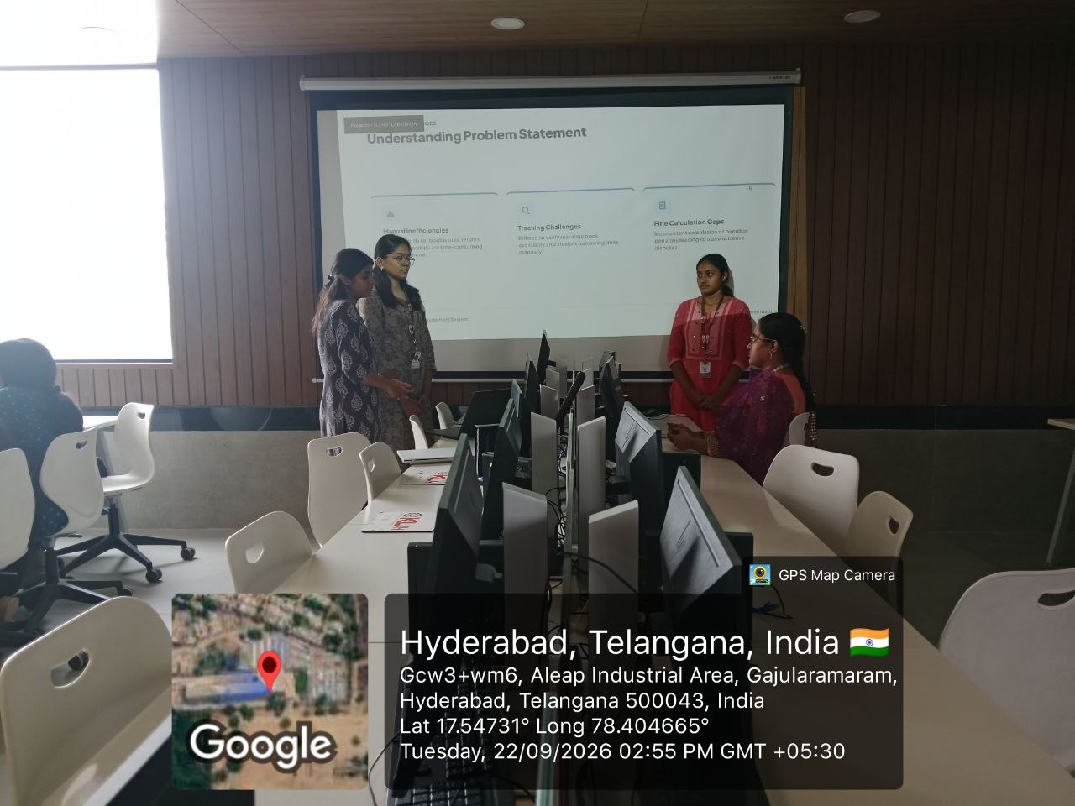
GEO TAG PHOTO

